Slide 1
Model diagnostics for linear models
Beware the Monkey’s Paw

Slide 2
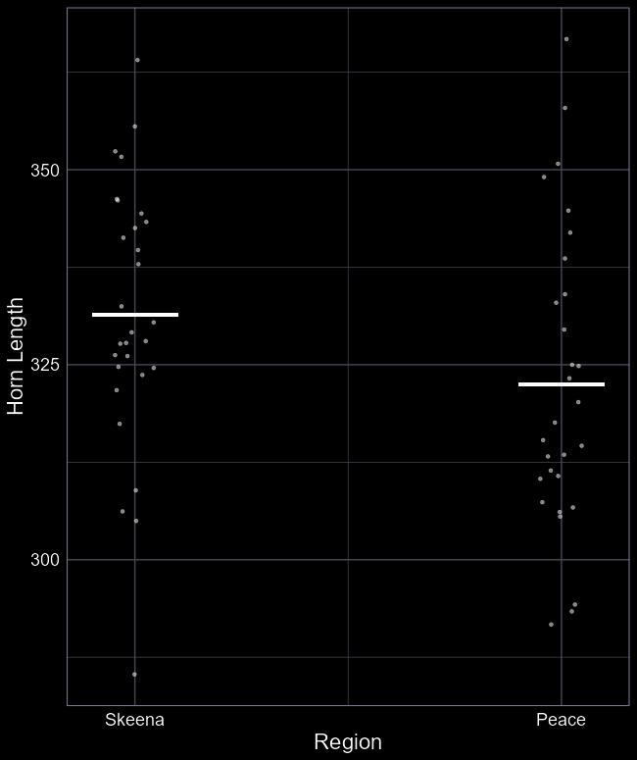
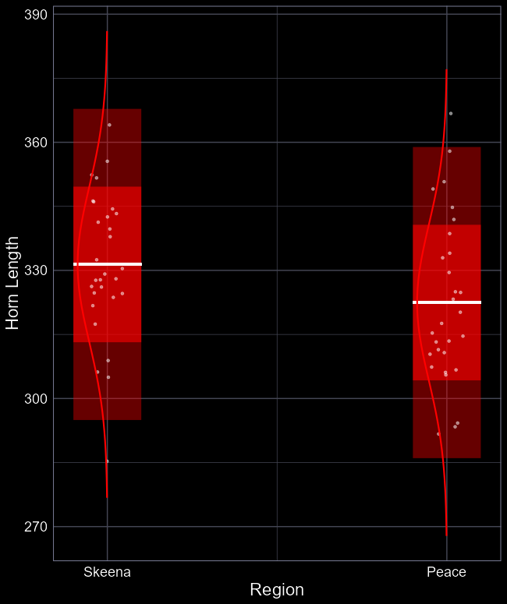
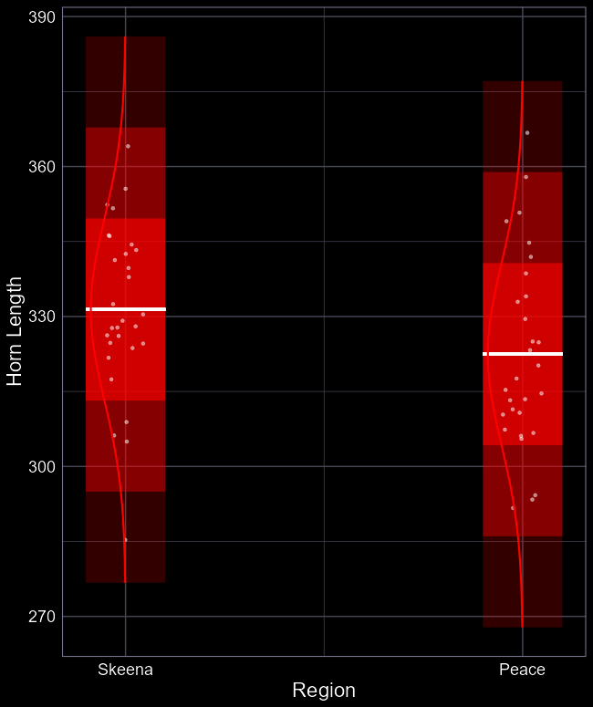
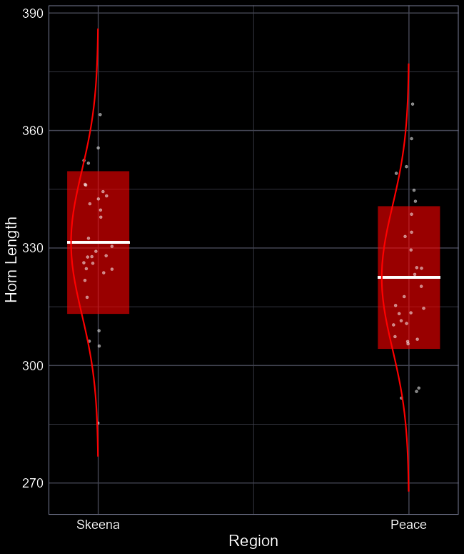
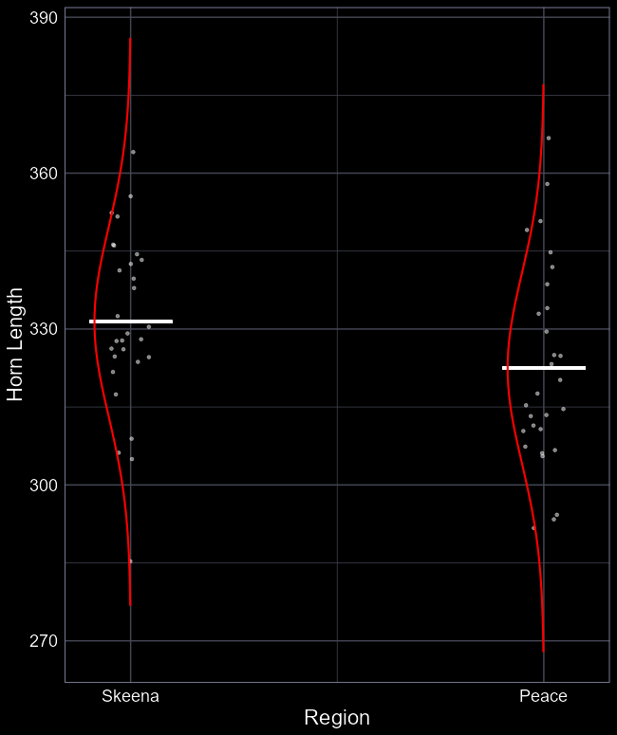
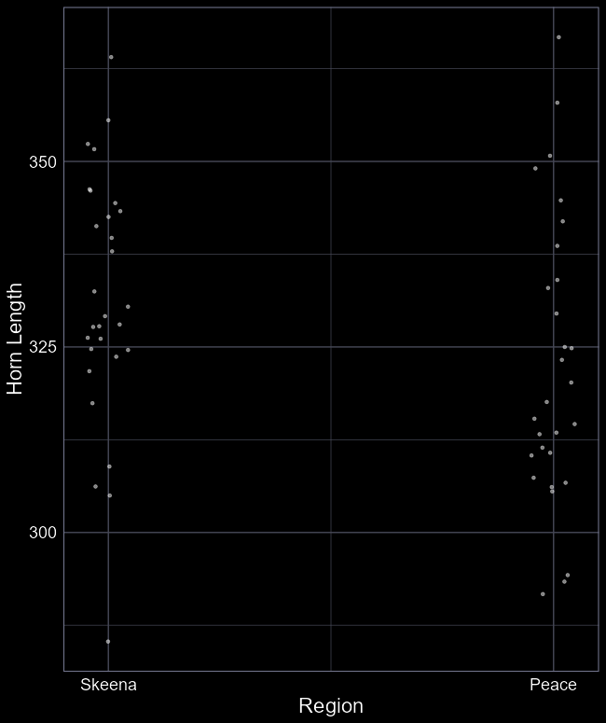


Assumption of $Normality$
We’re still fitting a model that assumes a $Normal$ distribution
$$y_{i}∼Normal(μ_{i}, σ_{i})$$
$$μ_{i}=β_{0}+β_{1}×Skeena_{i}$$
We still assume our residuals should be normally distributed, given $σ_{i}$
Meaning:
  Observations should lie within the estimate standard deviation (SD)
  Ca. 69% should be within 1 SD
  Ca. 95% should be within 2 SD
  Ca. 97.5% should be within 3 SD

Slide 3
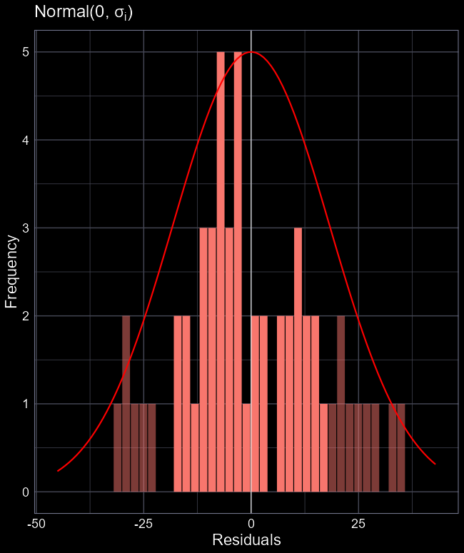

Slide 4
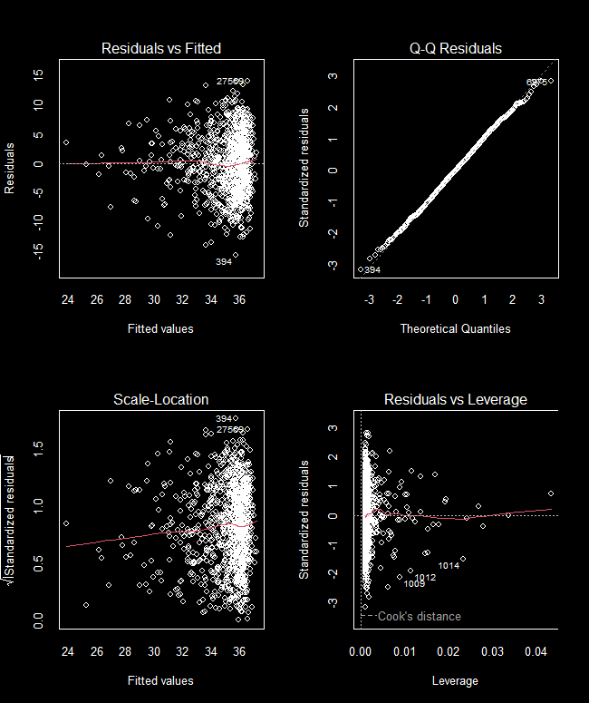
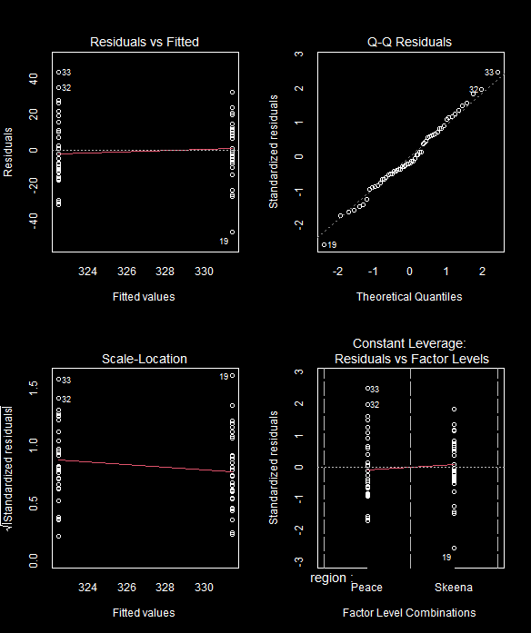
The four horseman
plot(shp_model)
Returns four diagnostics plots
Are these the same as last week?
Why are they slightly different?

Slide 5
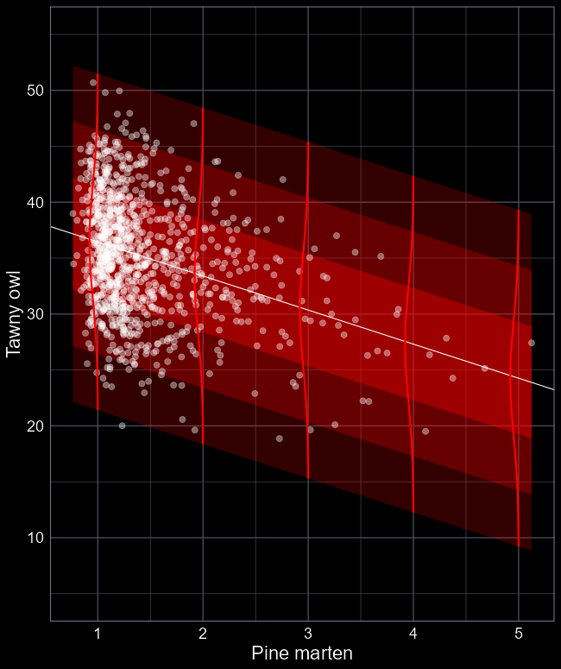

Slide 7
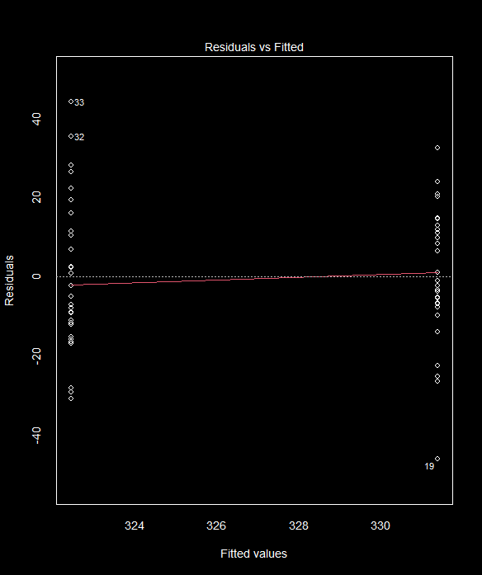
Residuals vs Fitted
Row 33 in dataset
322 predicted horn length
367 actual horn length
45 residual error
Horn length from 1975
Orientation:
  Y-axis: Residual error
  X-axis: Predicted (“Fitted”) values
  Dashed line at 0 residual is when our model perfectly predicts an observation
  Red line is a moving average
Two “groups” because left is Peace (horns of 322 mm), right is Skeena (331 mm)

Slide 8

Residuals vs Fitted
What we want to see:
Broadly equal spread of residuals for each Peace and Skeena
Happy that it’s equal?
Small dataset ($n=58$), so matching assumptions perfectly very unlikely, even if there is no problem
Model is suitable in my view

Slide 9
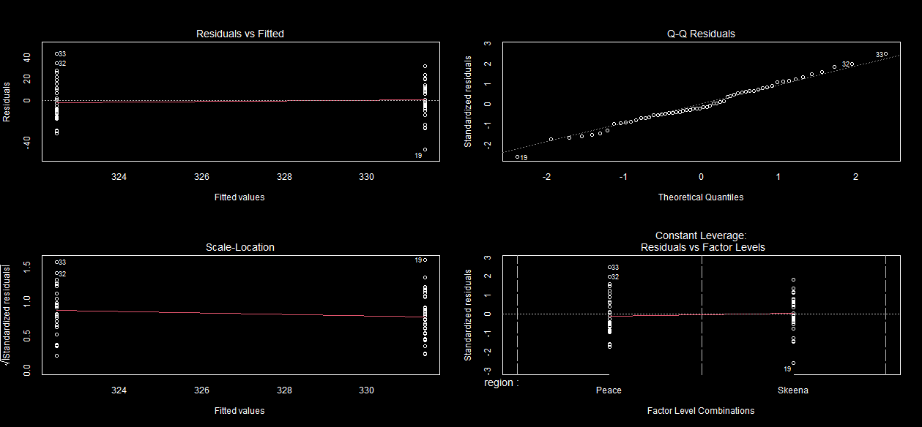
The four horseman
Fine (ish)

Slide 10
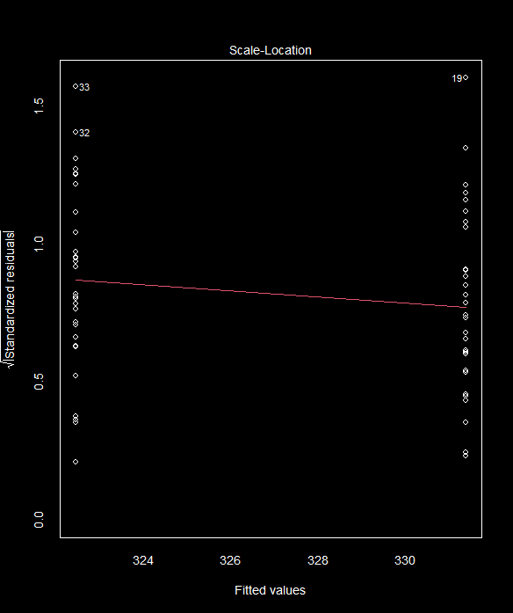

Scale-Location
Residuals (y-axis) are now:
  Standardised (divide by $σ$)
  Square rooted (all values are positive)
We want to see two things here:
  Ca. 95% of Std. Residuals are < 2
  Equal variations in groups

Slide 11
The four horseman
Fine (ish)
Good

Slide 12
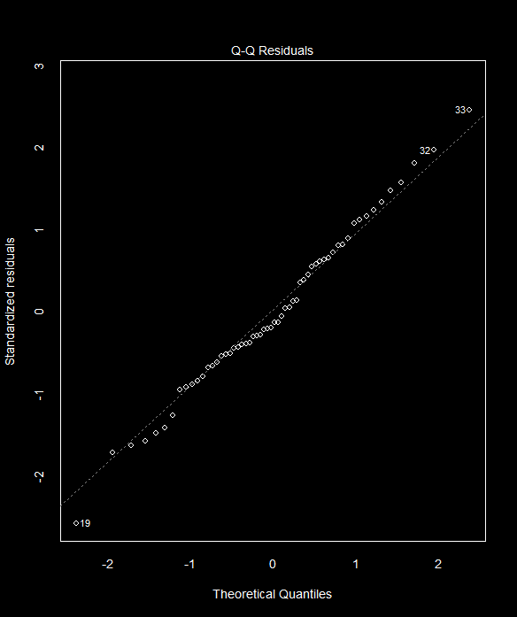


Q-Q Residuals
Assumed $Normal$ distribution
We assume our residuals are $Normally$ distributed
Y-axis are standardised residuals
  To 1 standard deviation
X-axis are what we would assume, given $Normal(0, σ)$
If $Normally$ distributed, then points should mostly lie on the dashed line

Slide 13
The four horseman
Fine (ish)
Good
Good

Slide 14
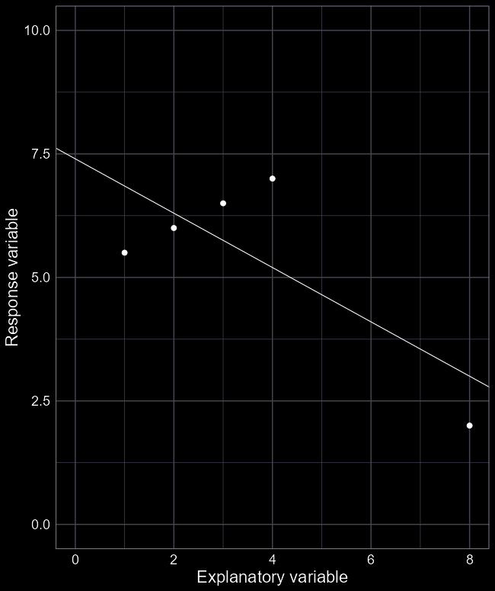
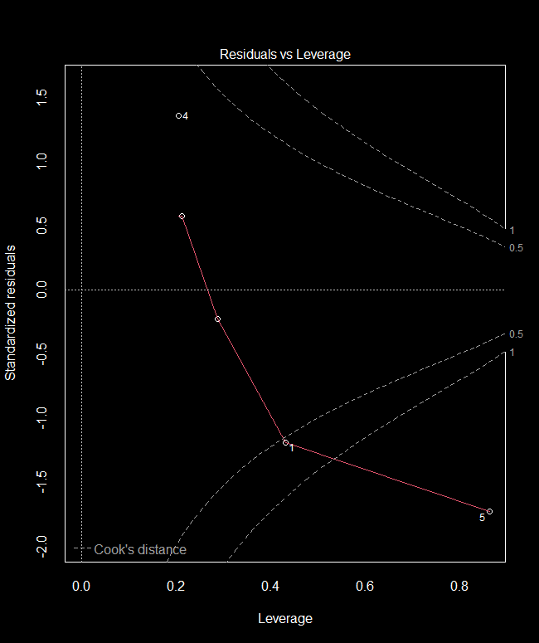
Residuals vs Leverage
Last week we were looking for observations that had a disproportionate effect on the straight line
We don’t have a straight line now
High Leverage
High Influence

Slide 15
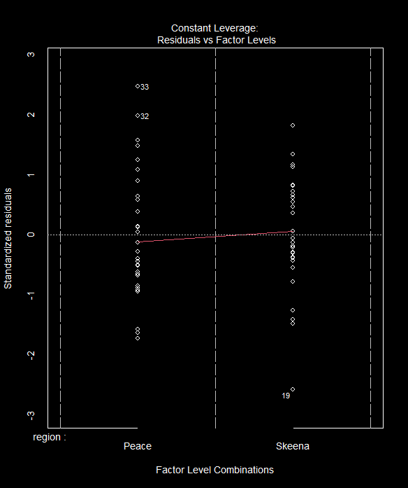
Residuals vs Leverage
Instead, we now check how our residuals are distributed according to standard deviation
  Ca. 69% should be within 1 SD
  Ca. 95% should be within 2 SD
  Ca. 97.5% should be within 3 SD
Seems good

Slide 16
The four horseman
Fine (ish)
Good
Good
Good

Slide 17
Linear models with categorical variable: Full workflow example

Slide 18

Who watches the most Netflix?
Which “region” watched the most Netflix in 2022?
Let’s find out:
  Average total time spent watching Netflix since opening account per country (response)
  Region (explanatory)

Slide 19
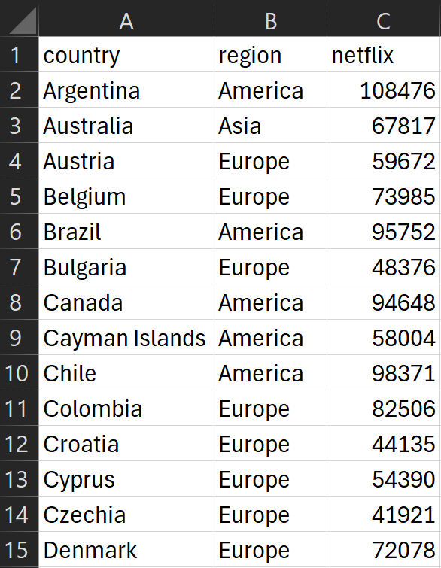
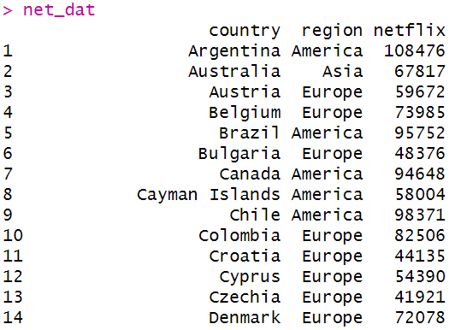

Step 1: Get data
Ensure data is in tabular form
Each row represents the average from country ($i$)
  The “$i^{th}$ country”
For each country, we have a measure of:
  Average Netflix time (minutes)
  The region each country is in
net_dat <- read.csv(“file_path”,
header = TRUE)

Slide 20
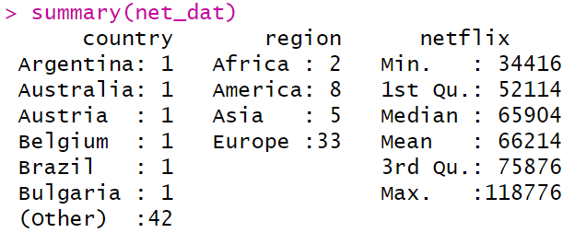
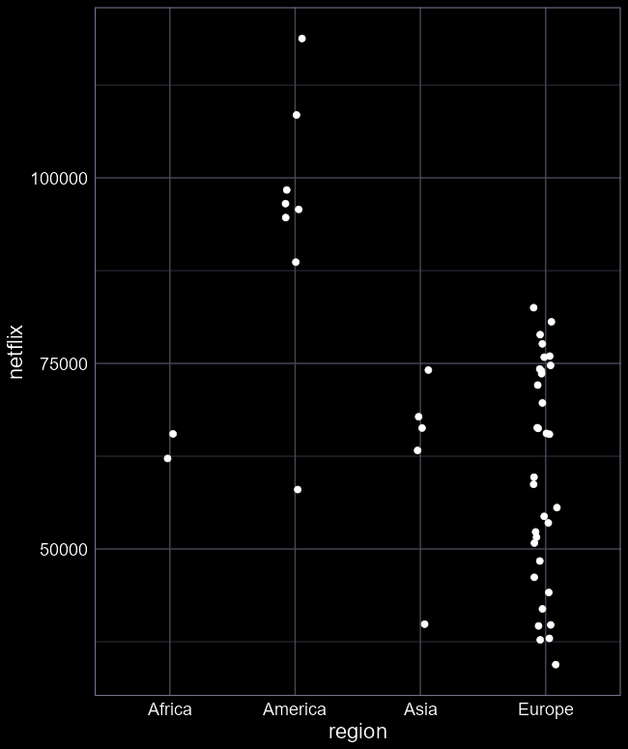
Step 2: Explore data
Explore the data
summary(cc_dat)
ggplot(cc_dat) +
geom_point(
aes(x = region,
y = netflix))
How reliable is the sampling?
Foresee any issues for the analysis?

Slide 21

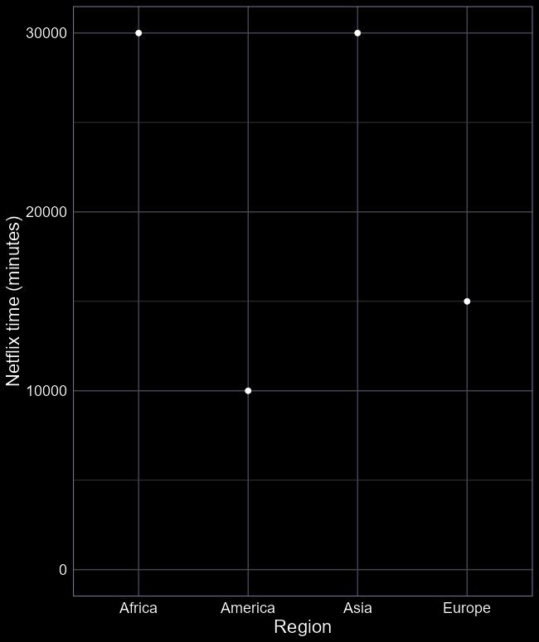




Step 3: Fit model
$$β_{2}=0$$
Unless we see any issues, we can proceed to fitting a linear model
net_mod <- lm(netflix ~ region,
data = net_dat)
Easiest step to do
Keep in mind how groups are handled
$$β_{3}= \\ −15000$$
$$β_{1}= \\ −20000$$
$$β_{0}= \\ 30000$$

Slide 22
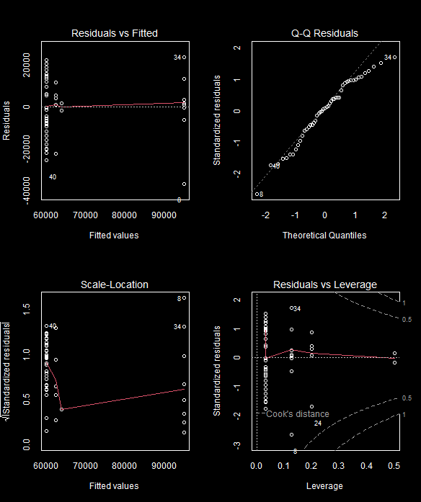

Step 4: Diagnose
With model run, we need to check for the Monkey’s Paw
Check diagnostics
Note that with multiple categories, we get the Leverage plot again
Any issues?
  Unequal variance?
  Starting to stretch that assumption of $Normally$ distributed residuals
  But tiny sample size
  Can we still proceed?

Slide 23

Step 5: Summarise
The model has four parameters to estimate
summary(net_mod)
  $β_{0}=63848$(Minutes in Africa)
  $β_{1}=31052$ (Difference with America)
  $β_{2}=−1576$ (Difference with Asia)
  $β_{3}=−3847$ (Difference with Europe)
Which region watches the most television?
Which region watches the least Netflix?
> summary(net_mod)
Call:
lm(formula = netflix ~ region, data = net_dat)
Residuals:
Min 1Q Median 3Q Max
-36895 -8615 1316 12452 23877
Coefficients:
Estimate Std. Error t value Pr(>|t|)
(Intercept) 63848 10567 6.042 2.92e-07 ***
regionAmerica 31052 11814 2.628 0.0118 *
regionAsia -1576 12503 -0.126 0.9003
regionEurope -3847 10882 -0.354 0.7254
---
Signif. codes: 0 ‘***’ 0.001 ‘**’ 0.01 ‘*’ 0.05 ‘.’ 0.1 ‘ ’ 1
Residual standard error: 14940 on 44 degrees of freedom
Multiple R-squared: 0.4471, Adjusted R-squared: 0.4094
F-statistic: 11.86 on 3 and 44 DF, p-value: 8.043e-06

Slide 24
Step 6: Plot predictions
With model fit, we can now show the full predicted relationship
Generate fake values of explanatory variable
Use predict to apply equation to fake data
Convert SE to 95% CI
Plot

Slide 25
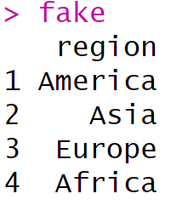
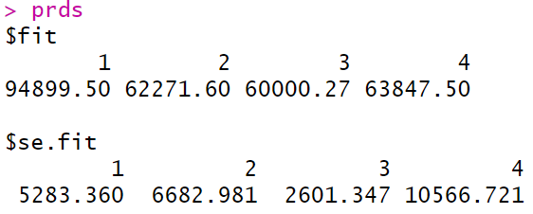
Step 6: Plot predictions
With model fit, we can now show the full predicted relationship
Generate fake values of explanatory variable
fake <- data.frame(
region = unique(net_dat$region))
prds <- predict(net_mod,
newdata = fake,
se.fit = TRUE)

Slide 26
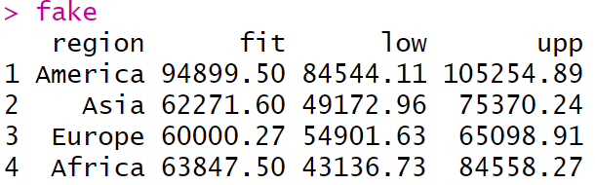
Step 6: Plot predictions
fake$fit <- prds$fit
fake$low <- prds$fit-prds$se.fit * 1.96
fake$upp <- prds$fit+prds$se.fit * 1.96

Slide 27
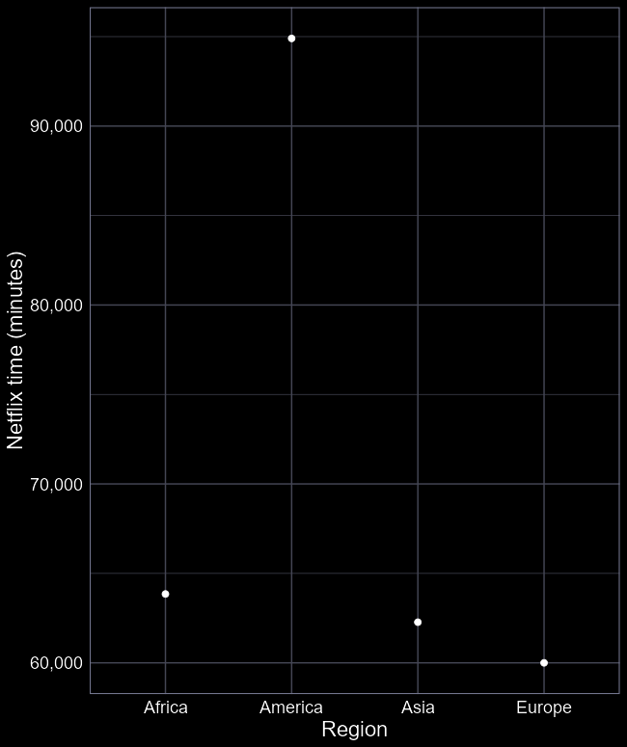
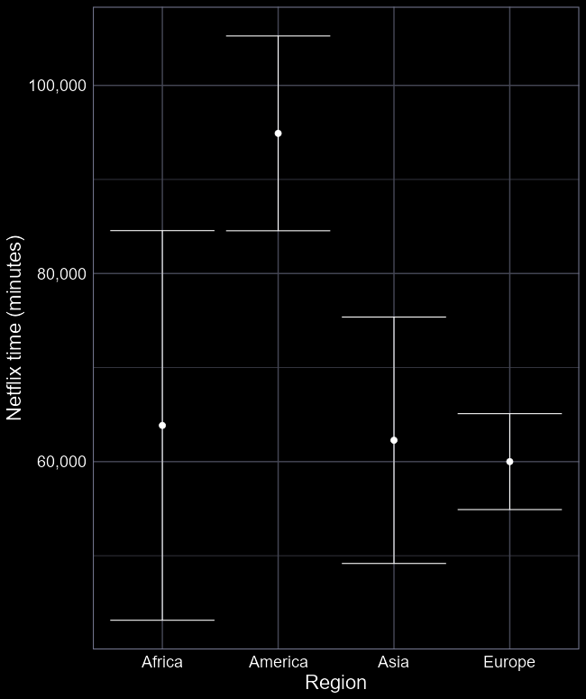
Step 6: Plot predictions
With model fit, we can now show the full predicted relationship
ggplot(fake) +
geom_line(aes(
x = region,
y = fit))
Add the 95% CI
… +
geom_errorbar(
aes(x = region,
ymin = low,
ymax = upp))

Slide 28
Step 7: Discuss
Do some regions watch more Netflix than others?
How conclusive is our evidence?
  Are there any alternative ways to interpret the results?

Slide 29
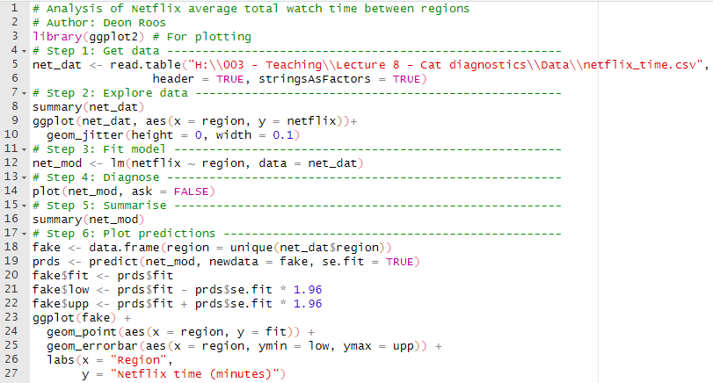
tl;dr
Complete analysis in 27 lines of code

